Slide 1


SMART INDIA HACKATHON 2026
TITLE PAGE
Problem Statement ID – SIH26070
Problem Statement Title- AI/ML-based system for identification, classification, and prediction of tropical cyclone patterns using multi-source satellite data
Theme - Smart Education
PS Category- Software
Organization – Ministry of Earth Sciences (MoES)
Team Name – Code over Coffee
Institute name – Swami Keshvanand Institute of Technology, Ramnagariya road, Jagatpura, Jaipur

Slide 2

AI/ML-Based Tropical Cyclone Identification, Classification & Prediction Using Multi-Source Satellite Data
Problem
•Time-Consuming: Manually analyzing satellite images takes a lot of time.
Needs Experts: Cyclone detection and classification depend on skilled meteorologists.
Prediction Delays: Manual analysis can delay predictions of cyclone path and strength results inmassive loss of life and property in coastal India.
Human Errors: Different experts may give different results due to human judgment.
Proposed Solution
An AI/ML pipeline that ingests satellite imagery (INSAT-3D/3DR + other sources), automatically detects cyclone formation, classifies intensity (per IMD’s depression → super cyclone scale), and predicts track/intensity evolution. It will continuously analyze real-time and historical data to identify changing cyclone patterns. The system will provide early predictions of cyclone movement, intensity, and possible landfall. This will help meteorologists make faster, more accurate decisions and enable timely disaster preparedness and warnings.

Slide 3

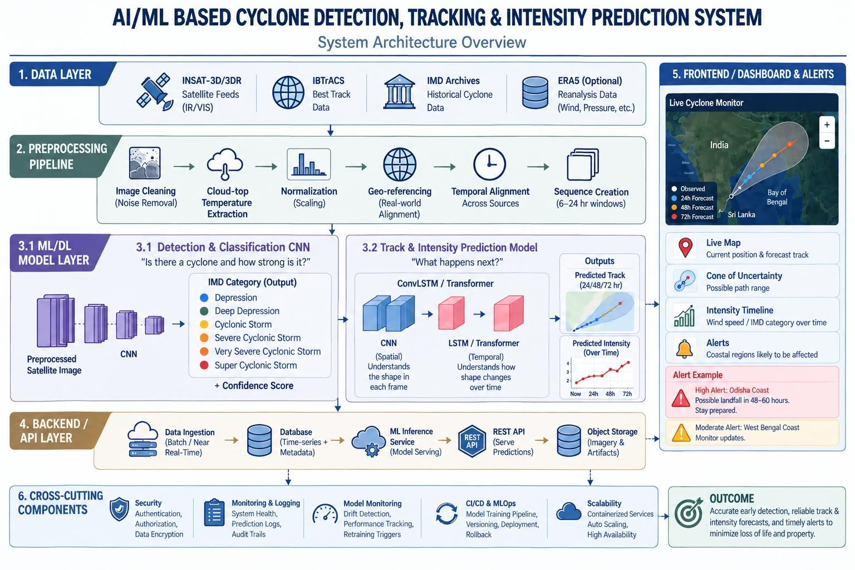
TECHNICAL APPROACH

Slide 4

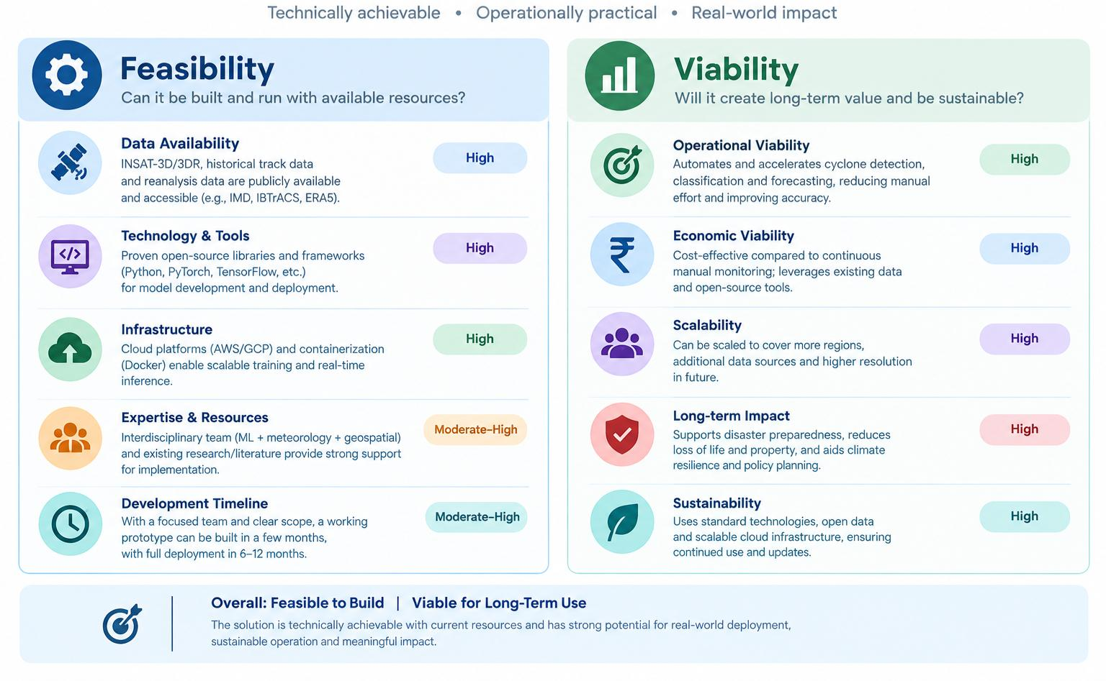
FEASIBILITY AND VIABILITY

Slide 5

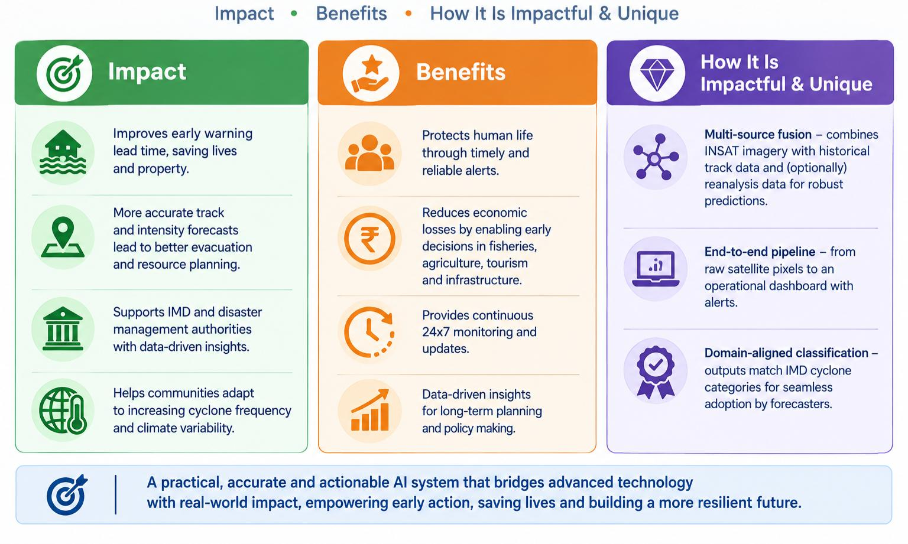
IMPACTS AND BENEFITS

Slide 6

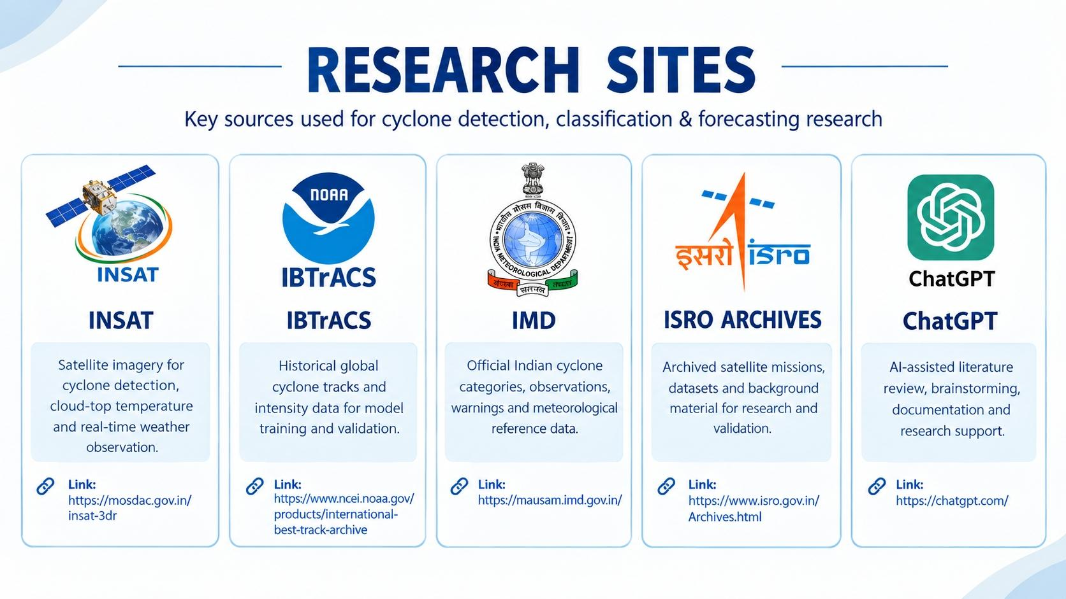
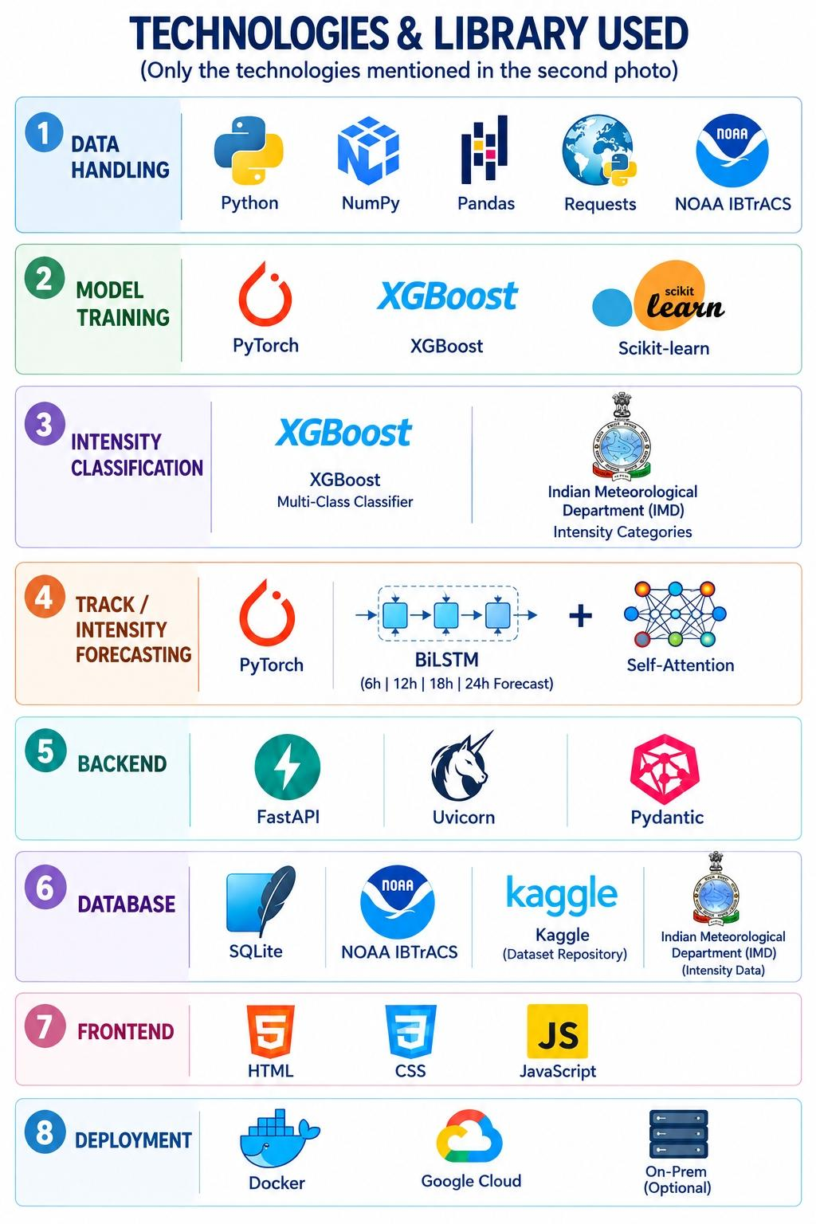

RESEARCH AND REFERENCES

